Slide 1
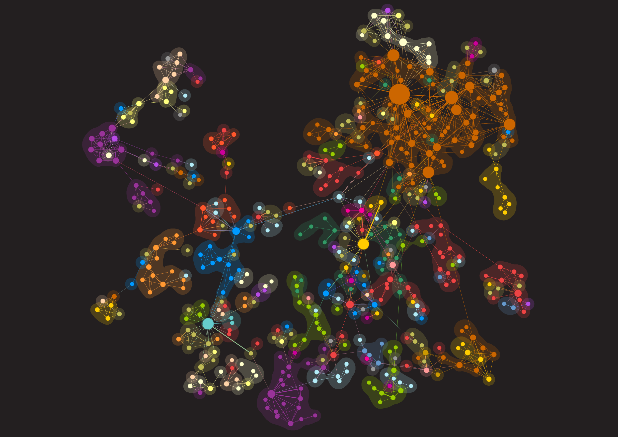
Introduction to Bibliometric Visualization
14 July 2016

Slide 2
Why create bibliometric visualizations?
Identify current and future collaborations
Identify strengths
Expose gaps in our collections
Demonstrate interdisciplinary work

Slide 3
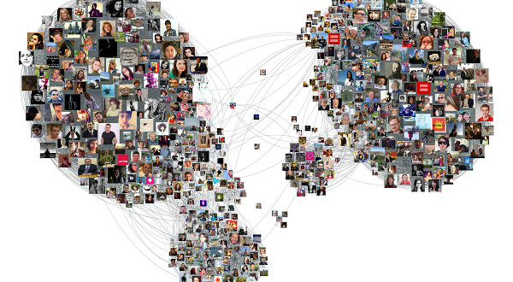
Network Science
https://www.linkedin.com/pulse/facebook-photo-network-visualization-gephi-r-natalino-busa

Slide 4
Nodes & Edges
Edge
Node

Slide 5
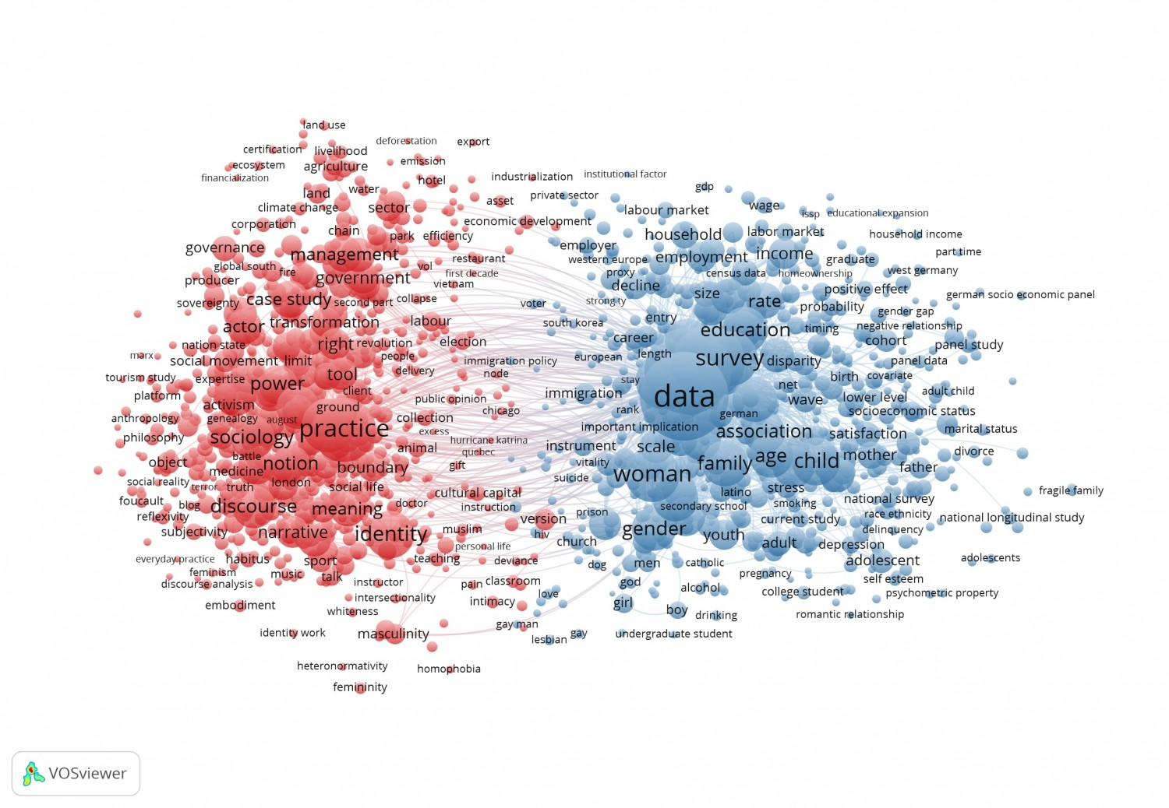
Nodes continued:
https://www.cwts.nl/blog?article=n-q2v294

Slide 6
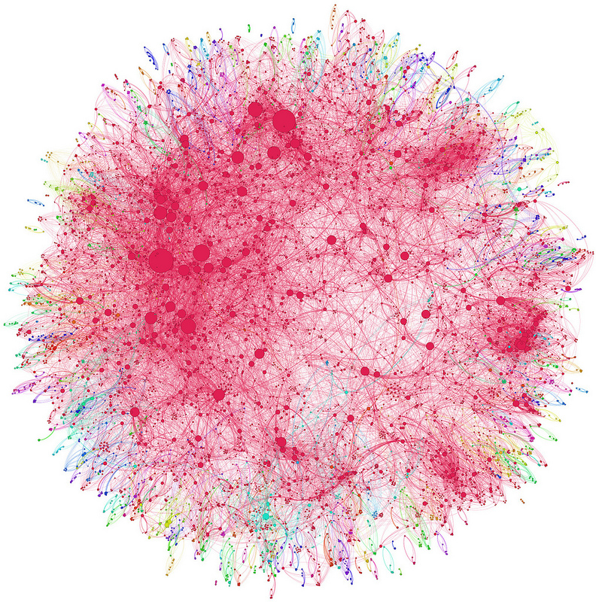
Publication Networks
Three types:
1. Collaboration Networks
2. Semantic Networks
3. Publication Citation Networks

Slide 7
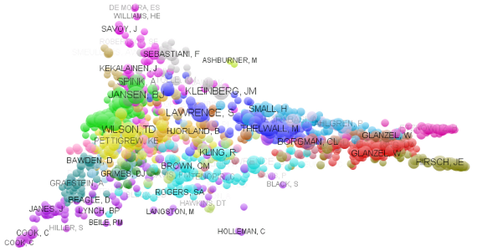
Collaboration Networks
https://citationculture.wordpress.com/2011/10/

Slide 8
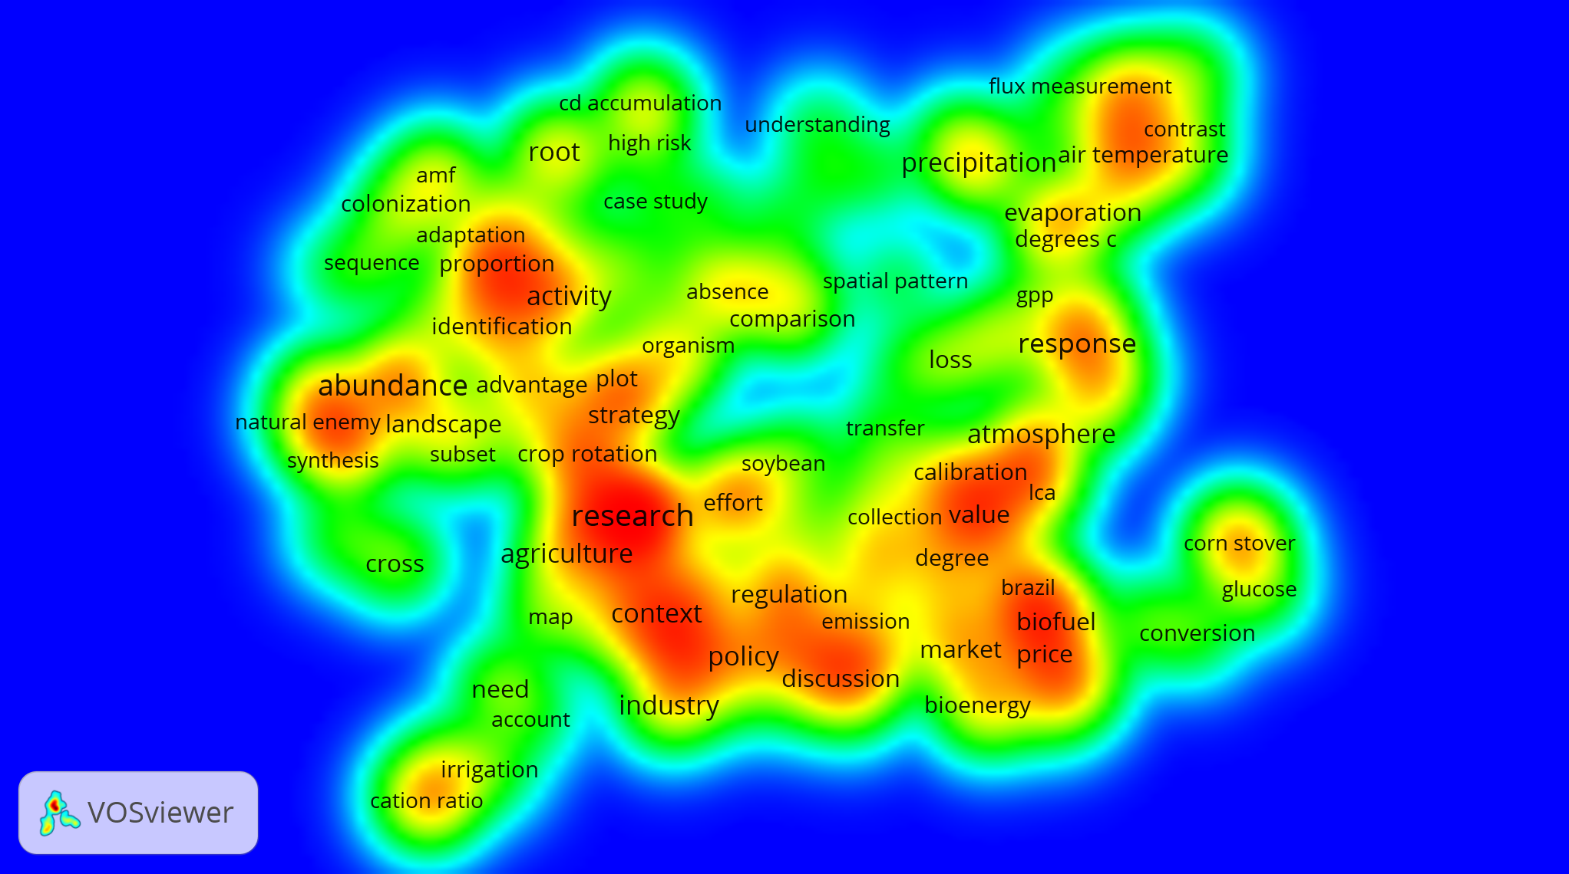
Semantic Networks
http://www.betahaus.com/berlin/2011/12/workshop-text-network-analysis-with-gephi/

Slide 9
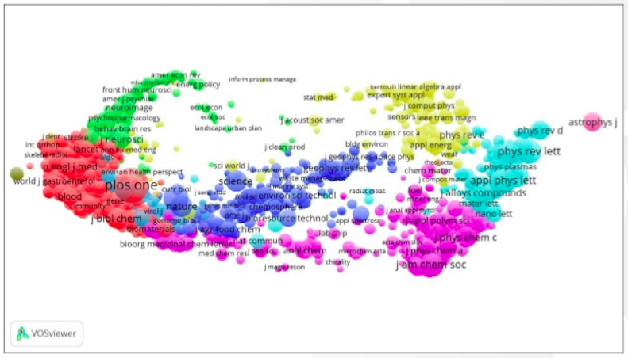
Citation Networks
http://www.slideshare.net/NeesJanvanEck/network-visualization-finetuning-layout-techniques-for-different-types-of-networks

Slide 10
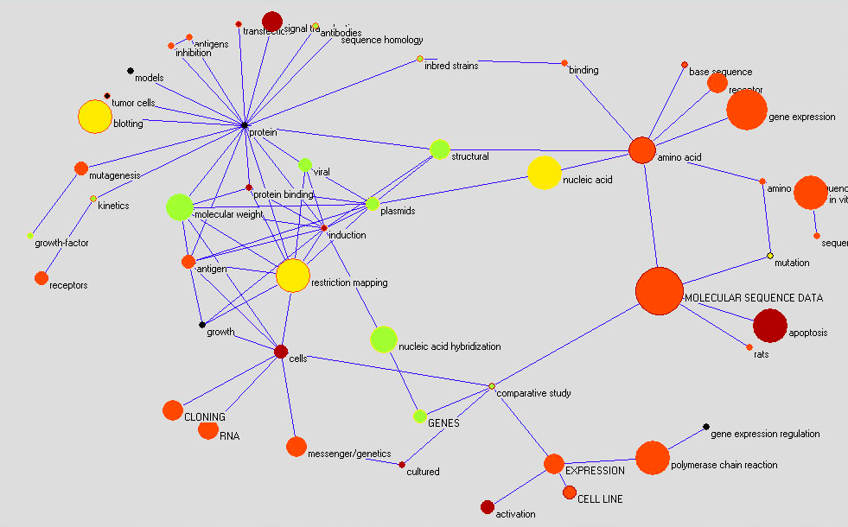

Bibliometric Visualization Tools
Science of Science or Sci2

Slide 11
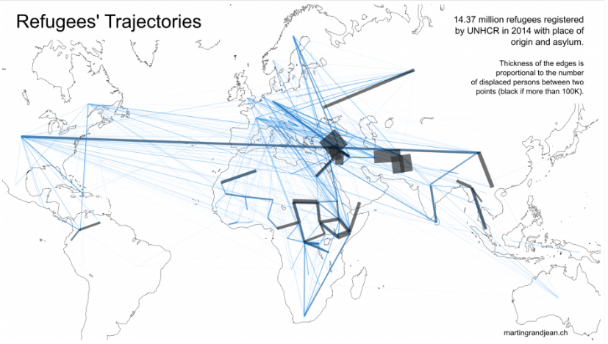

Bibliometric Visualization Tools
Gephi
http://www.martingrandjean.ch/data-visualization-map-refugees/

Slide 12
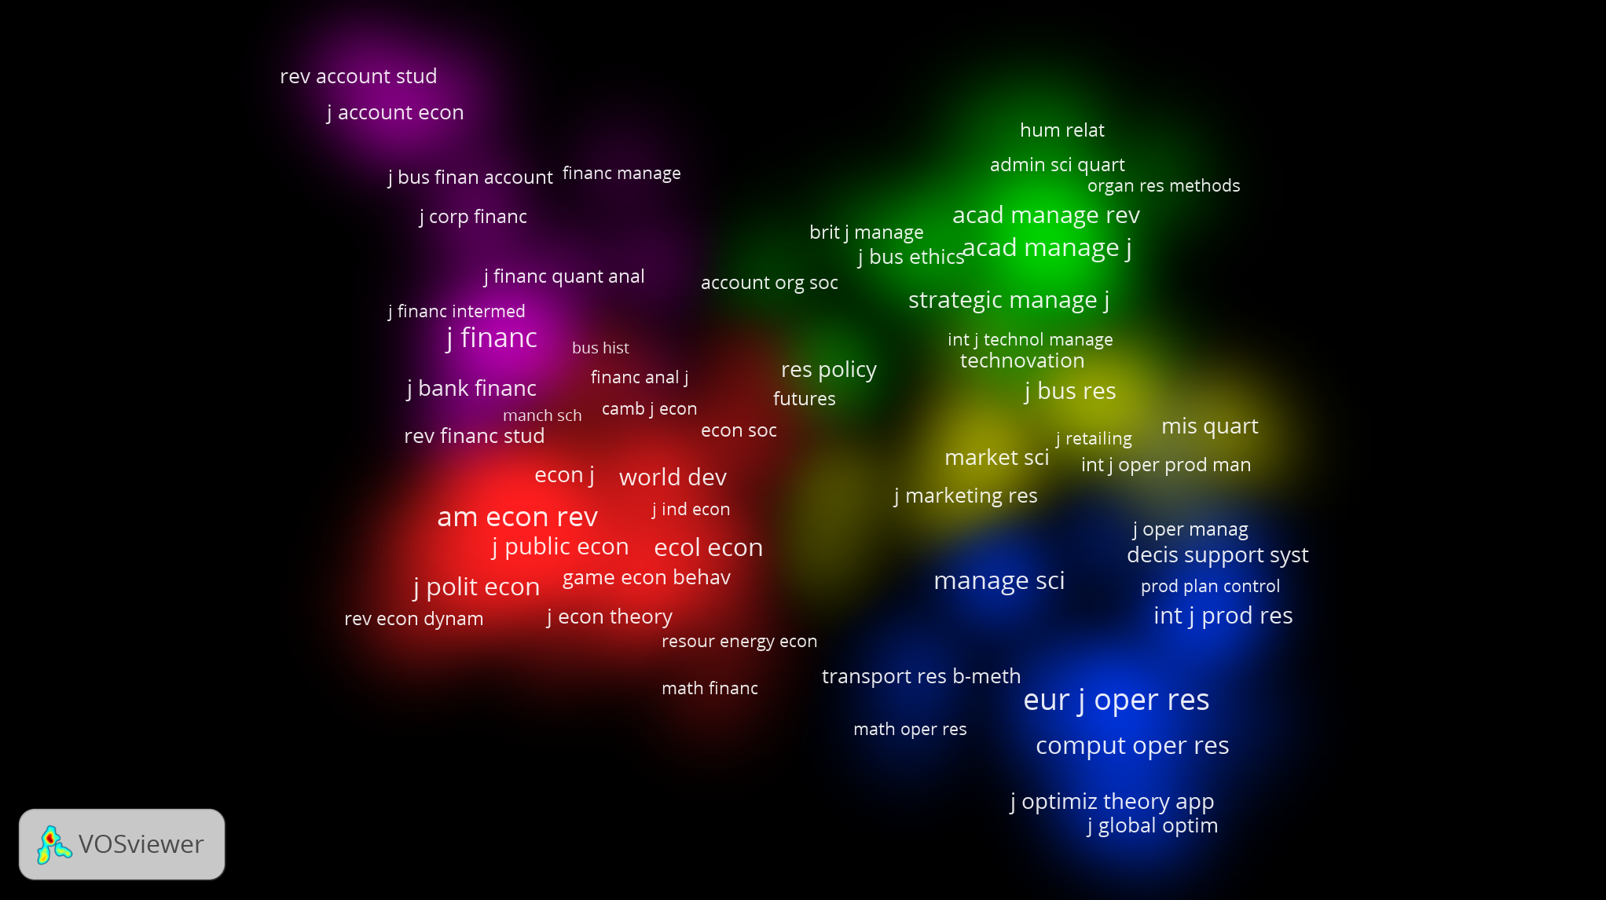
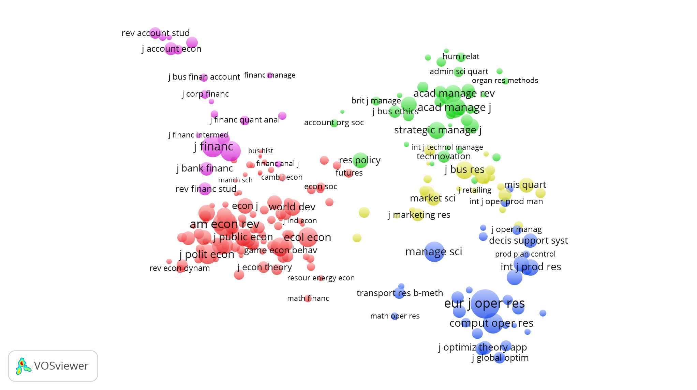

Bibliometric Visualization Tools
VosViewer

Slide 13
Next…
Demonstration of VosViewer
Hands-on time

